Slide 1
Distributed Replication
Lecture 16, Oct 22nd 2015

Slide 2
How’d we get here?
Failures & single systems; fault tolerance techniques added redundancy (ECC memory, RAID, etc.)
Conceptually, ECC & RAID both put a “master” in front of the redundancy to mask it from clients -- ECC handled by memory controller, RAID looks like a very reliable hard drive behind a (special) controller

Slide 3
Simpler examples...
Replicated web sites
e.g., Yahoo! or Amazon:
DNS-based load balancing (DNS returns multiple IP addresses for each name)
Hardware load balancers put multiple machines behind each IP address

Slide 4
Read-only content
Easy to replicate - just make multiple copies of it.
Performance boost: Get to use multiple servers to handle the load;
Perf boost 2: Locality. We’ll see this later when we discuss CDNs, can often direct client to a replica near it
Availability boost: Can fail-over (done at both DNS level -- slower, because clients cache DNS answers -- and at front-end hardware level)

Slide 5
But for read-write data...
Must implement write replication, typically with some degree of consistency

Slide 6

Sequential Consistency (1)
Behavior of two processes operating on the same data item. The horizontal axis is time.
P1: Writes “W” value a to variable “x”
P2: Reads NIL from “x” first and then a

Slide 7
Sequential Consistency (2)
A data store is sequentially consistent when:
The result of any execution is the same as if the (read and write) operations by all processes on the data store …
Were executed in some sequential order and …
the operations of each individual process appear …
in this sequence
in the order specified by its program.

Slide 8
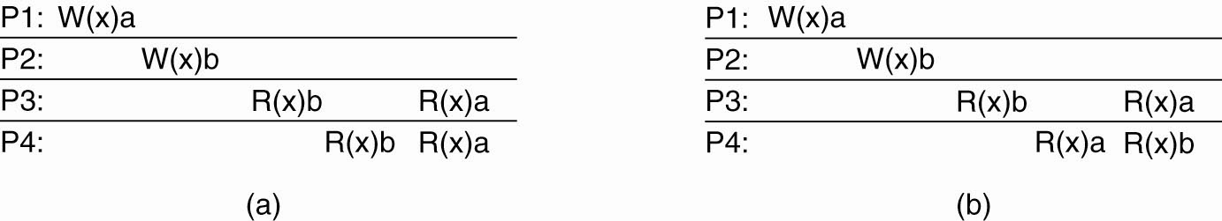
Sequential Consistency (3)
(a) A sequentially consistent data store.
(b) A data store that is not sequentially consistent.
Notes:
(b) Is not sequentially consistent since at the end, P3 and P4 will have different values of x ( a or b)

Slide 9
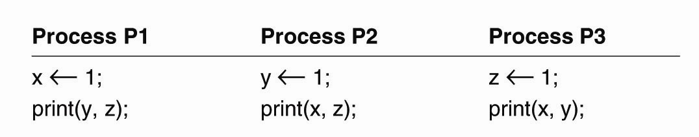
Sequential Consistency (4)
Figure 7-6. Three concurrently-executing processes.
Notes:
How are there 720 orderings? 6 statements, so 6! = 720.
However many of them are not valid since you cannot have the print (y,z) before x <-1 for P1, etc.

Slide 10
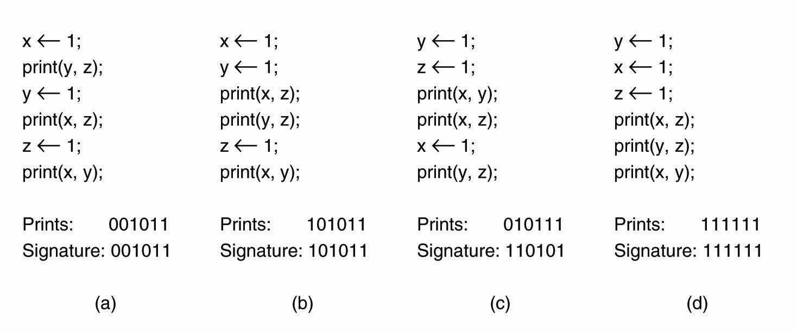
Sequential Consistency (5)
Figure 7-7. Four valid execution sequences for the processes of Fig. 7-6. The vertical axis is time.
Overall, there are 90 (out of 720) valid statement orderings that are allowed under sequental consistency
Notes:
How are there 720 orderings? 6 statements, so 6! = 720.
However many of them are not valid since you cannot have the print (y,z) before x <-1 for P1, etc.
Prints: shows the actual output of the 2 bit strings for each of the print(-, -) statements, so 2 bits for each P1,P2,P3 = 6 bits in total.
Signature: Shows the values of the prints if P1 (y,z), P2(x,z), P3 (x,y) were printed in that fixed order.

Slide 11
Causal Consistency (1)
For a data store to be considered causally consistent, it is necessary that the store obeys the following condition:
Writes that are potentially causally related …
must be seen by all processes
in the same order.
Concurrent writes …
may be seen in a different order
on different machines.

Slide 12
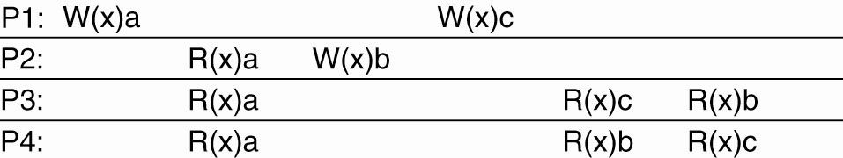
Causal Consistency (2)
Figure 7-8. This sequence is allowed with a causally-consistent store, but not with a sequentially consistent store.
Notes:
Note: P1: W(x)c and P2: W(x)b are concurrent so its not important that all processes see them in the same order

Slide 13
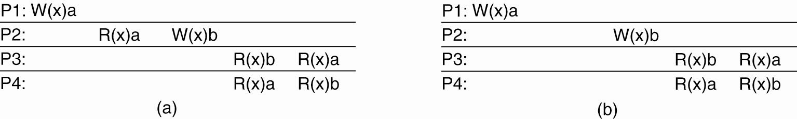
Causal Consistency (3)
Figure 7-9. (a) A violation of a causally-consistent store.
Notes:
P2 W(x) b may be causally realted to the W (x) a -- for example it may be the result of value read in P2: R (x) a and hence the two writes are causally related.
If so, then P3 and P4 must see them in the same order and the currnet output is incorrect and violates causally consistent ordering.

Slide 14
Causal Consistency (4)
Figure 7-9. (b) A correct sequence of events in a causally-consistent store.
Notes:
In this figure, P1: W (x)a is concurrent with P2: W(x) b and hence they are not causally related, and hence P3 and P4 could see them in diffferent order -- so OK.

Slide 15
Important ?: What is the consistency model?
Just like in filesystems, want to look at the consistency model you supply
Real Life example: Google mail.
Sending mail is replicated to ~2 physically separated datacenters (users hate it when they think they sent mail and it got lost); mail will pause while doing this replication.
Q: How long would this take with 2-phase commit? in the wide area?
Marking mail read is only replicated in the background - you can mark it read, the replication can fail, and you’ll have no clue (re-reading a read email once in a while is no big deal)
Weaker consistency is cheaper if you can get away with it.
Notes:
Recap 2-PC
Messages in first phase
A: Coordinator sends “CanCommit?” to participants
B: Participants respond: “VoteCommit” or “VoteAbort”
Messages in the second phase
A: if any participant “VoteAbort” transaction aborts. Co-ordinator sends “DoAbort” to everyone => release locks
Else, send “DoCommit” to everyone => complete transaction

Slide 16
Replicate: State versus Operations
Possibilities for what is to be propagated:
Propagate only a notification of an update. - Sort of an “invalidation” protocol
Transfer data from one copy to another. - Read-to-Write ratio high, can propagate logs (save bandwidth)
Propagate the update operation to other copies - Don’t transfer data modificaitons, only operations – “Active replication)
Notes:
Invalidation part just tells the replicas that their copy of the data is invalid and maybe even which part is invalid.
Key thing is no more than an invalidation message is sent.
Advantage: Low network bandwith
Transfer copy from one to the other:
read-to-write ratio high, transfer data to replica. Can also
Propagate update operations -= assumes that each repliaca has a process capable of actively keeping its data in sync by update operations

Slide 17
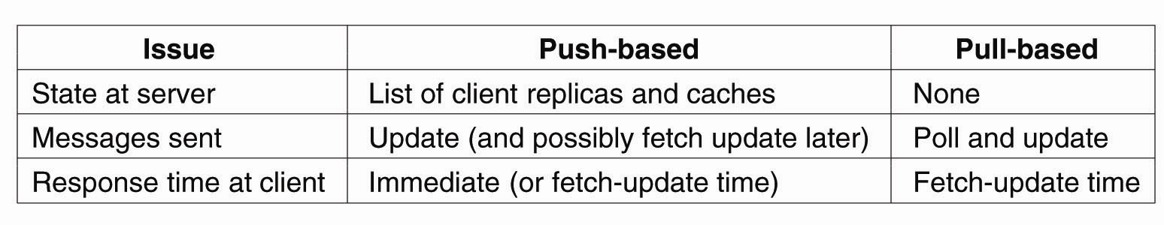
When to Replicate: Pull versus Push Protocols
Comparison between push- and pull-based protocols in the case of multiple-client, single-server systems. - Pull Based: Replicas/Clients poll for updates (caches) - Push Based: Server pushes updates (stateful)

Slide 18
Failure model
We’ll assume for today that failures and disconnections are relatively rare events - they may happen pretty often, but, say, any server is up more than 90% of the time.
We’ll come back later and look at “disconnected operation” models. For example, the CMU CODA system, that allowed AFS filesystem clients to work “offline” and then reconnect later.

Slide 19
Tools we’ll assume
Group membership manager
Allow replica nodes to join/leave
Failure detector
e.g., process-pair monitoring, etc.

Slide 20
Goal
Provide a service
Survive the failure of up to f replicas
Provide identical service to a non-replicated version (except more reliable, and perhaps different performance)

Slide 21
We’ll cover today...
Primary-backup
Operations handled by primary, it streams copies to backup(s)
Replicas are “passive”, i.e. follow the primary
Good: Simple protocol. Bad: Clients must participate in recovery.
Quorum consensus
Designed to have fast response time even under failures
Replicas are “active” - participate in protocol; there is no master, per se.
Good: Clients don’t even see the failures. Bad: More complex.

Slide 22
Primary-Backup
Clients talk to a primary
The primary handles requests, atomically and idempotently, just like your lock server would
Executes them
Sends the request to the backups
Backups reply, “OK”
ACKs to the client

Slide 23
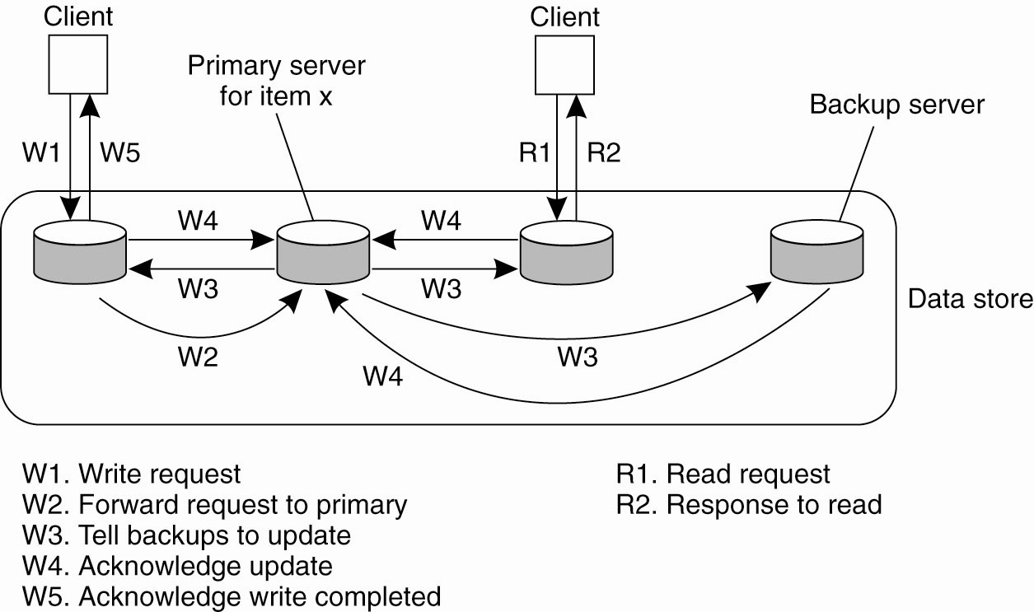
Remote-Write PB Protocol
Updates are blocking, although non-blocking possible
Notes:
The simplest form of primary backup protocol that supports replication is where all the writes go to a single server (fixed) and the read operations can be carried out locally.
Due to blocking operation, processes will see the effects of the most recent write.
Non blocking means that the Primary issues an ACK after it receives and commits a local copy of item “x” and then tells the backups/replica to udpate it. This comes at the cost of fault tolenrace.

Slide 24
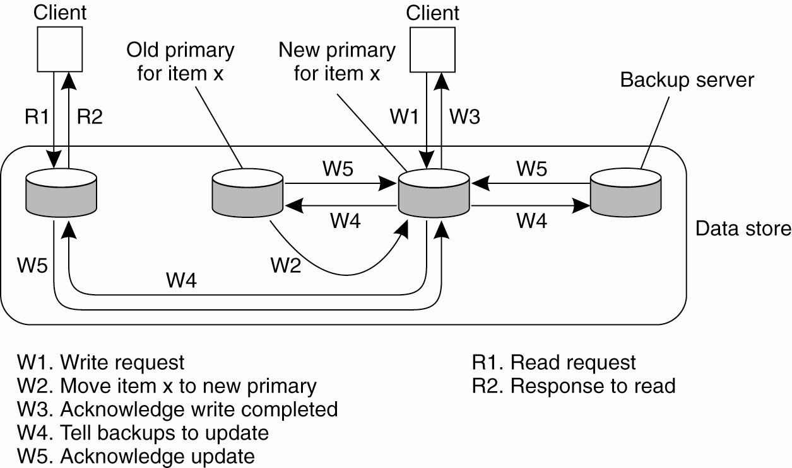
Local-Write P-B Protocol
Primary migrates to the process wanting to process update For performance, use non-blocking op.
Notes:
Variant of PB, where the primary migrates copy of a particular item migrates to the process that wants to perform update.
Advatage: multiple successive write opeations can be peformed locally on the replicas, while reading processes can access their local copy.
Note, for the actual performance advantage, you must apply non-blocking protocol.
This is a useful scheme for Mobile computers. Before disconnecting, a mobile client can become the primary server for the files it wants to update. All update operations (in disconnected mode) are done locally and then propagated from the primary to the backups to bring things into a consistent state again.

Slide 25
Primary-Backup
Note: If you don’t care about strong consistency (e.g., the “mail read” flag), you can reply to client before reaching agreement with backups (sometimes called “asynchronous replication”).
This looks cool. What’s the problem?
What do we do if a replica has failed?
We wait... how long? Until it’s marked dead.
Primary-backup has a strong dependency on the failure detector
This is OK for some services, not OK for others
Advantage: With N servers, can tolerate loss of N-1 copies

Slide 26
Implementing P-B
Remember logging? :-)
Common technique for replication in databases and filesystem-like things: Stream the log to the backup. They don’t have to actually apply the changes before replying, just make the log durable.
You have to replay the log before you can be online again, but it’s pretty cheap.

Slide 27
p-b: Did it happen?
Client
Primary
Backup
Commit!
Log
Commit!
OK!
OK!
Log
OK!
Failure here:
Commit logged only at primary
Primary dies? Client must re-send to backup

Slide 28
p-b: Happened twice
Client
Primary
Backup
Commit!
Commit!
Log
OK!
Log
OK!
Failure here:
Commit logged at backup
Primary dies? Client must check with backup
(Seems like at-most-once / at-least-once... :)

Slide 29
Problems with p-b
Not a great solution if you want very tight response time even when something has failed: Must wait for failure detector
For that, quorum based schemes are used
As name implies, different result:
To handle f failures, must have 2f + 1 replicas (so that a majority is still alive)
Notes:
Major difference, you want replicated Write protocols so that you can write to multiple replicas instead of just one.

Slide 30
Paxos [Lamport]
quorum consensus usually boils down to the Paxos algorithm.
Very useful functionality in big systems/clusters.
Some notes in advance:
Paxos is painful to get right, particularly the corner cases. Steal an implementation if you can. See Yahoo’s “Zookeeper” as a starting point.
There are lots of optimizations to make the common / no or few failures cases go faster; if you find yourself implementing, research these.
Paxos is expensive, as we’ll see. Usually, used for critical, smaller bits of data and to coordinate cheaper replication techniques such as primary-backup for big bulk data.

Slide 31
Paxos requirement
Correctness (safety):
All nodes agree on the same value
The agreed value X has been proposed by some node
Fault-tolerance:
If less than N/2 nodes fail, the rest should reach agreement eventually w.h.p
Liveness is not guaranteed

Slide 32
Paxos: general approach
Elect a replica to be the Leader
Leader proposes a value and solicits acceptance from others
If a majority ACK, the leader then broadcasts a commit message.
This process may be repeated many times, as we’ll see.
Paxos slides adapted from Jinyang Li, NYU; some terminology from “Paxos Made Live” (Google)
Notes:
Each node in PAXOS runs as a proposer, acceptor and learner

Slide 33
Why is agreement hard?
What if >1 nodes think they’re leaders simultaneously?
What if there is a network partition?
What if a leader crashes in the middle of solicitation?
What if a leader crashes after deciding but before broadcasting commit?
What if the new leader proposes different values than already committed value?

Slide 34
Basic two-phase
Coordinator tells replicas: “Value V”
Replicas ACK
Coordinator broadcasts “Commit!”
This isn’t enough
What if there’s more than 1 coordinator at the same time? (let’s solve this first)
What if some of the nodes or the coordinator fails during the communication?

Slide 35
Combined leader election and two-phase
Prepare(N) -- dude, I’m the master
if N >= hN, Promise(N) -- ok, you’re the boss. (I haven’t seen anyone with a higher N)
if majority promised: Accept(V, N) -- please agree on the value V
if N >= nH, ACK(V, N) -- Ok!
if majority ACK: Commit(V)

Slide 36
Multiple coordinators
The value N is basically a lamport clock.
Nodes that want to be the leader generate an N higher than any they’ve seen before
If you get NACK’d on the propose, back off for a while - someone else is trying to be leader
Have to check N at later steps, too, e.g.:
L1: N = 5 --> propose --> promise
L2: N = 6 --> propose --> promise
L1: N = 5 --> accept(V1, ...)
Replicas: NACK! Someone beat you to it.
L2: N = 6 --> accept(V2, ...)
Replicas: Ok!
Notes:
Coordinators are essentially Leaders in Paxos

Slide 37
But...
What happens if there’s a failure? Let’s say the coordinator crashes before sending the commit message
Or only one or two of the replicas received it
Notes:
Question?

Slide 38
Paxos solution
Proposals are ordered by proposal #
Each acceptor may accept multiple proposals
If a proposal with value v is chosen, all higher proposals must have value v

Slide 39
Paxos operation: node state
Each node maintains:
na, va: highest proposal # and its corresponding accepted value
nh: highest proposal # seen
myn: my proposal # in current Paxos

Slide 40
Paxos operation: 3-phase protocol
Phase 1 (Prepare)
A node decides to be leader (and propose)
Leader chooses myn > nh
Leader sends <prepare, myn> to all nodes
Upon receiving <prepare, n>
If n < nh
reply <prepare-reject>
Else
nh = n
reply <prepare-ok, na,va>
See the
relation to
lamport
clocks?
This node will not accept
any proposal lower than n

Slide 41
Paxos operation
Phase 2 (Accept):
If leader gets prepare-ok from a majority
V = non-empty value corresponding to the highest na received
If V= null, then leader can pick any V
Send <accept, myn, V> to all nodes
If leader fails to get majority prepare-ok
Delay and restart Paxos
Upon receiving <accept, n, V>
If n < nh
reply with <accept-reject>
else
na = n; va = V; nh = n
reply with <accept-ok>
Notes:
Why pick any V?

Slide 42
Paxos operation
Phase 3 (Commit)
If leader gets accept-ok from a majority
Send <commit, va> to all nodes
If leader fails to get accept-ok from a majority
Delay and restart Paxos

Slide 43
Paxos operation: an example
nh=N0:0
na = va = null
nh=N1:0
na = va = null
nh=N2:0
na = va = null
Prepare,N1:1
Prepare,N1:1
nh= N1:1
na = null
va = null
nh: N1:1
na = null
va = null
ok, na= va=null
ok, na =va=nulll
Accept,N1:1,val1
Accept,N1:1,val1
nh=N1:1
na = N1:1
va = val1
nh=N1:1
na = N1:1
va = val1
ok
ok
Decide,val1
Decide,val1
N0
N1
N2

Slide 44
Replication Wrap-Up
Primary/Backup quite common, works well, introduces some time lag to recovery when you switch over to a backup. Doesn’t handle as large a set of failures. f+1 nodes can handle f failures.
Paxos is a general, quorum-based mechanism that can handle lots of failures, still respond quickly. 2f+1 nodes.
Notes:
Understand this.

Slide 45
Beyond PAXOS
Many follow ups and variants
RAFT consensus algorithm
https://raft.github.io/
Great vizualization of how it work
http://thesecretlivesofdata.com/raft/

